Slide 1
Women in Tech: Becoming the Ally
Deepthi Goguri
She/Her
Database Administrator

Slide 2




Deepthi
Goguri
She/Her
Database Administrator
Data Platform MVP
Co-Organizer for DEI User Group, Microsoft Data and AI South Florida User Group
Volunteer for Data Platform WIT User Group
Loves Arts and Crafts
@dbanuggets
https://dbanuggets.com/
https://www.linkedin.com/in/deepthigoguri/

Slide 3
“I am the only woman in this Room”

Slide 4
Women are 49.7% of the global population Women are 46.6% of the workforce Women are 26.2% of the tech workforce

Slide 5
Importance of perspective: It’s life or death

Slide 6
Air Bag Technology Engineering team
Designed by all male engineering team
Designed to standard height and weight of male
For 20 years, airbags were only tested on adult male dummies
Women and young kids were killed when the airbag was deployed initially
Not until 2008, did the NHTSA require airbags be tested on smaller test dummies

Slide 7
Why did you choose to be here?
You believe you can make the change

Slide 8
What value this session will provide?
You’ll leave this session with a series of actionable steps that you can take to either improve your own career or to be an ally to those around you.

Slide 9
Before beginning…

Slide 10
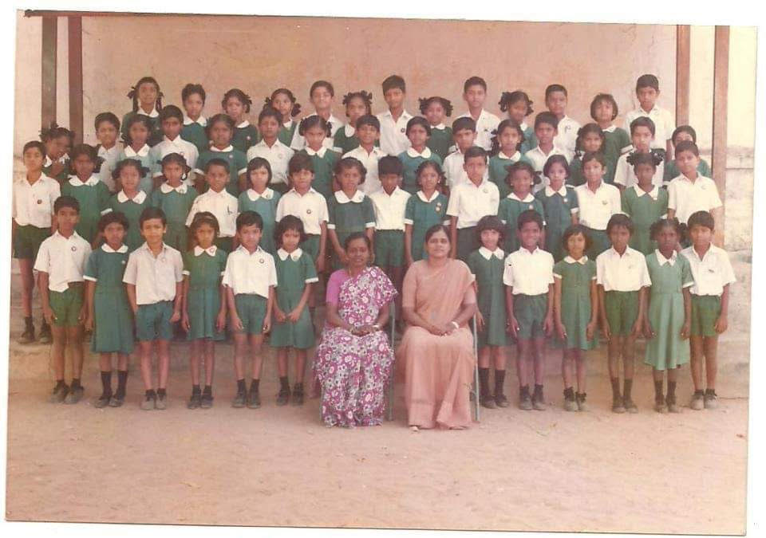

Slide 11
In many cultures…
Globally, there are 129 million girls not in school
Women don’t always get to make a choice
Every year, almost 12 million girls are married before the age of 18

Slide 12
Making my choice: When I finally decided to take Computer Technology as my Major…

Slide 13

Pharmacist NOT by Choice

Slide 14
Stood up for myself and decided to do Masters in Computer Technology

Slide 15

Graduated

Slide 16
When I finally wanted to pursue my career as a DBA...
People started questioning me…
Are you Sure???
It’s a challenging job, try for an easy job
You are a woman, think about your kids. Take it easy on your career
For every 100 DBA’s, there are very few women.

Slide 17
74% of high school aged girls showed interest in STEM but only 18% end up choosing STEM
Source: https://thebridge.social/the-gender-gap-for-women-in-technology/

Slide 18
How to increase this percentage?

Slide 19
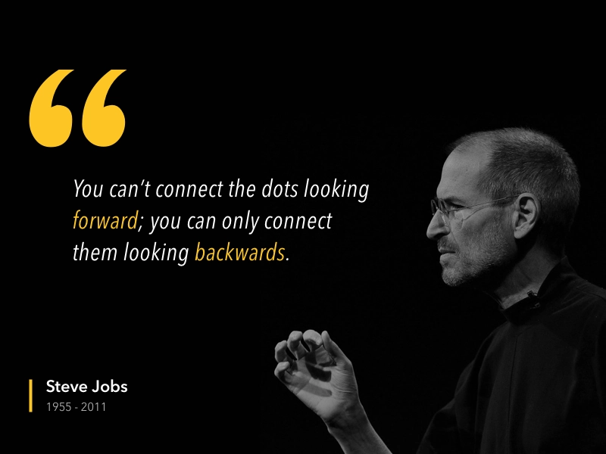
Source: https://dribbble.com/shots/3466252-Quote-Steve-Jobs

Slide 20
Many Reasons..
Cultural Factors
Unconscious bias
Lack of Exposure
Unequal pay
Toxic work environments

Slide 21
Cultural Factors

Slide 22
Cultural Factors
Gender discrimination since birth
Many countries, educating a girl child is a big thing
Challenges don’t stop there
Gender and racial discrimination (imbalance and opportunities)

Slide 23
Unconscious bias

Slide 24
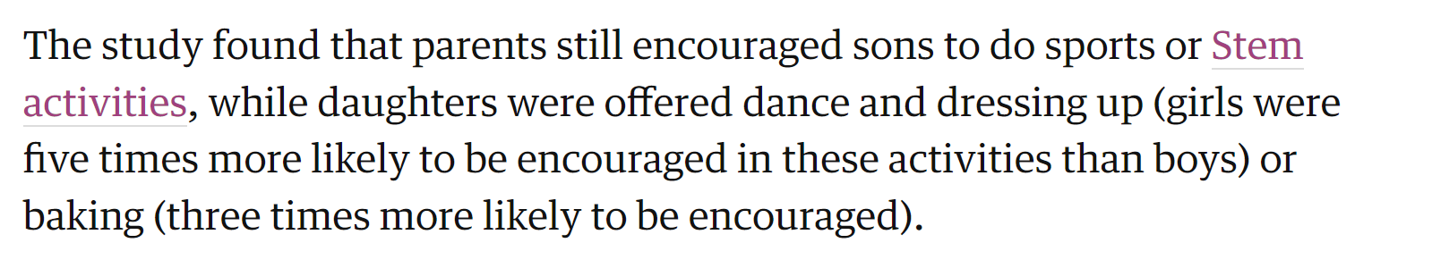
Gender Stereotypes
Source: https://www.theguardian.com/lifeandstyle/2021/oct/11/lego-to-remove-gender-bias-after-survey-shows-impact-on-children-stereotypes

Slide 25
When asked parents what career choice their kids may chose in the future
Parents of Boys | Parents of Girls
Computers Science Engineering Sports | Health Teaching Art Beauty
Source: https://www.youtube.com/watch?v=DthKXHDF7aU

Slide 26
Unconscious bias can affect Women
Lack of confidence
Lack of Self worth
They start believing tech is not for women

Slide 27
Lack of Exposure

Slide 28
Lack of Exposure
Computers and Technology
Coding
Inspiring teachers
Not many role models

Slide 29
Unequal pay

Slide 30
Unequal pay
Overall, women are paid 82 cents for every dollar paid to men.
For women of color, that number drops to 66 cents for every dollar paid to men.

Slide 31
The Wage Gap in 2022

Slide 32
Actionable Steps
Be aware of how much your role and experience makes in your area
Make sure your work is getting noticed
Be open to talk with your manager, do not sell yourself short
Take the challenging assignments

Slide 33
Toxic work environments

Slide 34
77% of Women in Tech Have Experienced a Toxic Work Culture Within the Last Five Years
Source: Here

Slide 35
Workplace Harassment: Steps to Stop it

Slide 36
Report to Human resources
Tips to support the women
Commit and lead by example
Train employees
Witness anonymous reporting

Slide 37
Becoming the Ally

Slide 38
Change begins with you… One step at a time

Slide 39
Encourage the little girls in your life
Encourage to learn coding
Teach the importance of technology and how it can make lives better
Tell them anyone can become anything
Encourage them to work on challenging tasks and fix the problems as they learn

Slide 40
Enroll them in the coding classes
Girls who code
Code.org
Scratch
Techgirlz
Codespark Academy
Source: https://www.create-learn.us/blog/coding-for-girls-best-platforms/

Slide 41
Become the Ally
Find out your individual biases
Pay attention to what people are saying
Don’t interrupt when others are talking
Encourage the ideas when shared
Little behaviors and patterns can affect a woman’s self confidence

Slide 42
Becoming the Ally
Intervene when interrupted
Invite women to share the ideas
Become a Mentor

Slide 43
Tips for Women
Find women who are ahead of you, connect to them on social media
Share your story and be vulnerable
Step out of the bucket others placed you in
Join Women in tech communities

Slide 44
Resources
https://query.prod.cms.rt.microsoft.com/cms/api/am/binary/RE1UMWz
https://www.youtube.com/watch?v=14J45xdRESA
https://www.youtube.com/watch?v=k12j-E1LsUU
https://explodingtopics.com/blog/women-in-tech
https://www.qwase.org/post/the-story-of-airbags-why-women-were-more-at-risk-of-getting-injured-in-car-accidents
https://www.forbes.com/sites/unicefusa/2022/08/18/unicef-10-things-keeping-girls-away-from-school/?sh=67d9ef527889
https://swhelper.org/2022/09/16/us-perception-of-the-gender-pay-gap-in-2021/

Slide 45
Deepthi Goguri
@dbanuggets
https://dbanuggets.com/
https://www.linkedin.com/in/deepthigoguri/

